Slide 1
Orthogonality and Least Squares
ORTHOGONAL SETS

Slide 2



ORTHOGONAL SETS
A set of vectors {u₁,…,u_{p}} in is said to be an orthogonal set if each pair of distinct vectors from the set is orthogonal, that is, if whenever
.
Theorem 4: If is an orthogonal set of nonzero vectors in , then S is linearly independent and hence is a basis for the subspace spanned by S.
$$ℝ^{n}$$
$$∙$$
$$ℝ^{n}$$

Slide 3




ORTHOGONAL SETS
Definition: An orthogonal basis for a subspace W of is a basis for W that is also an orthogonal set.
Theorem 5: Let {u₁,…,u_{p}} be an orthogonal basis for a subspace W of . For each y in W, the weights in the linear combination are given by
where
$$ℝ^{n}$$
$$ℝ^{n}$$
$$∙$$
$$∙$$

Slide 4





ORTHOGONAL SETS
Proof: The orthogonality of {u₁,…,u_{p}} shows that
Since is not zero, the equation above can be solved for c₁.
To find c_{j} for , compute and solve for c_{j}.
$$∙$$
$$∙$$
$$∙$$
$$∙$$
$$∙$$

Slide 5
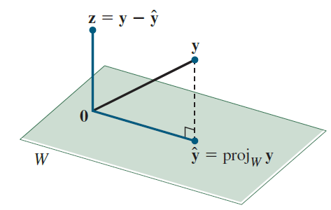
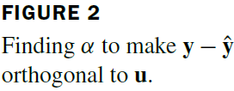


AN ORTHOGONAL PROJECTION
Given a nonzero vector u in , consider the problem of decomposing a vector y in into the sum of two vectors, one a multiple of u and the other orthogonal to u.
We wish to write
(1)
where for some scalar α and z is some vector orthogonal to u. See the following figure.
$$ℝ^{n}$$
$$ℝ^{n}$$

Slide 6









AN ORTHOGONAL PROJECTION
Given any scalar α, let , so that (1) is satisfied.
Then is orthogonal to u if an only if
That is, (1) is satisfied with z orthogonal to u if and
only if and .
The vector is called the orthogonal projection of y onto u, and the vector z is called the component of y orthogonal to u.
$$∙$$
$$∙$$
$$∙$$
$$∙$$
$$∙$$
$$∙$$
$$∙$$
$$∙$$
$$∙$$

Slide 7


AN ORTHOGONAL PROJECTION
If c is any nonzero scalar and if u is replaced by cu in the definition of , then the orthogonal projection of y onto cu is exactly the same as the orthogonal projection of y onto u.
Hence this projection is determined by the subspace L spanned by u (the line through u and 0).
Sometimes is denoted by proj_{L}y and is called the orthogonal projection of y onto L.
That is,
(2)
$$∙$$
$$∙$$

Slide 8

ORTHONORMAL SETS
A set {u₁,…,u_{p}} is an orthonormal set if it is an orthogonal set of unit vectors.
If W is the subspace spanned by such a set, then {u₁,…,u_{p}} is an orthonormal basis for W, since the set is automatically linearly independent, by Theorem 4.
The simplest example of an orthonormal set is the standard basis {e₁,…,e_{n}} for .
Any nonempty subset of {e₁,…,e_{n}} is orthonormal, too.
$$ℝ^{n}$$

Slide 9
AN ORTHOGONAL PROJECTION
Example 1: Let and . Find the
orthogonal projection of y onto u. Then write y as the sum of two orthogonal vectors, one in Span {u} and one orthogonal to u.
Solution: Compute

Slide 10
AN ORTHOGONAL PROJECTION
The orthogonal projection of y onto u is
and the component of y orthogonal to u is
The sum of these two vectors is y.

Slide 11
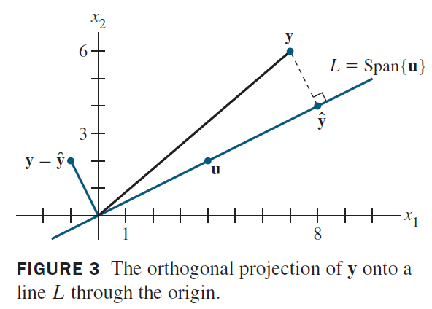
AN ORTHOGONAL PROJECTION
That is,
The decomposition of y is illustrated in the following figure.

Slide 12
AN ORTHOGONAL PROJECTION
Note: If the calculations above are correct, then will be an orthogonal set.
As a check, compute
Since the line segment in the figure on the previous slide between y and is perpendicular to L, by construction of , the point identified with is the closest point of L to y.

Slide 13

ORTHONORMAL SETS
Example 2: Show that {v₁, v₂, v₃} is an orthonormal basis of , where
, ,
Solution: Compute
$$ℝ^{3}$$

Slide 14

ORTHONORMAL SETS
Thus {v₁, v₂, v₃} is an orthogonal set.
Also,
which shows that v₁, v₂, and v₃ are unit vectors.
Thus {v₁, v₂, v₃} is an orthonormal set.
Since the set is linearly independent, its three vectors form a basis for . See the figure on the next slide.
$$ℝ^{3}$$

Slide 15
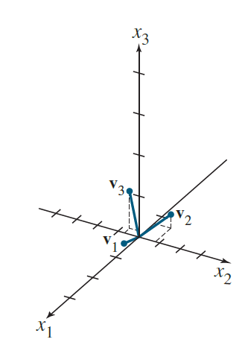
ORTHONORMAL SETS
When the vectors in an orthogonal set of nonzero vectors are normalized to have unit length, the new vectors will still be orthogonal, and hence the new set will be an orthonormal set.

Slide 16

ORTHONORMAL SETS
Theorem 6: An matrix U has orthonormal columns if and only if .
Proof: To simplify notation, we suppose that U has only three columns, each a vector in .
Let and compute
(3)
$$ℝ^{m}$$

Slide 17
ORTHONORMAL SETS
The entries in the matrix at the right are inner products, using transpose notation.
The columns of U are orthogonal if and only if
, ,
(4)
The columns of U all have unit length if and only if
, , (5)
The theorem follows immediately from (3)–(5).

Slide 18

ORTHONORMAL SETS
Theorem 7: Let U be an matrix with orthonormal columns, and let x and y be in .
Then
if and only if
Properties (a) and (c) say that the linear mapping preserves lengths and orthogonality.
$$ℝ^{n}$$

